Slide 1
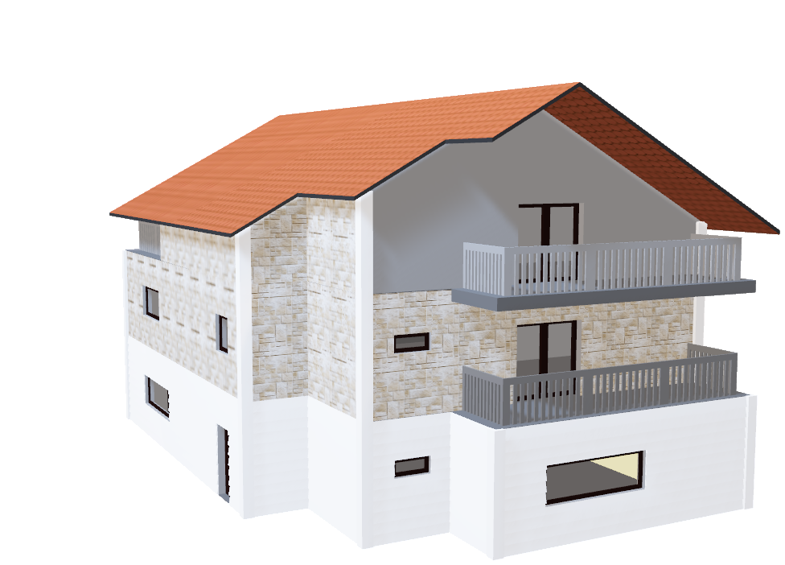
PRESENTATION
A case study from US-based housing company named “Surprise Housing”. The company is looking at prospective properties to buy houses at a price below their actual values and flip them at a higher price which will help the company to enter the real estate market.

Slide 2

HOUSING PRICE PREDICTION PROJECT

Slide 3
ACKNOWLEDGMENT
I would like to express my deepest gratitude to my SME Shwetank Mishra as well as Flip Robo Technologies who gave me the opportunity to do this project on Surprise Housing Price Prediction, which also helped me in doing lots of research wherein I came to know about so many new things.
Also, I have utilized a few external resources that helped me to complete the project. I ensured that I learn from the samples and modify things according to my project requirement.

Slide 4
INTRODUCTION
Surprise Housing is a US based Real estate and housing company who is trying to entry into Australian Real estate market. The company is looking at prospective properties to buy houses to enter the market. We are required to build a model using Machine Learning in order to predict the actual value of the prospective properties and decide whether to invest in them or not.
For this Surprise Housing wants to know:
Which variables are important to predict the sale price of house?
How do these feature variables describe the price of the house?

Slide 5
AGENDA
Analytical Problem Framing
Exploratory Data Analysis (EDA)
Visualizations
Data Pre-Processing on train and test datasets
Model/s Development and Evaluation
Performing hyper parameter tuning, saving the best model and predicting the label
Conclusion and future work discussion

Slide 6
Hardware - Software Requirements and Tools Used
Hardware Used:
RAM: 8 GB
CPU: AMD Ryzen 3 2200U with Radeon Vega Mobile Gfx 2.10 GHz

Slide 7
Hardware - Software Requirements and Tools Used
Software Used:
Programming language: Python
Distribution: Anaconda Navigator
Browser based language shell: Jupyter Notebook
Libraries/Packages Used:
Pandas, NumPy, matplotlib, seaborn, scikit-learn.

Slide 8
PROBLEM STATEMENT
Houses are one of the necessary need of each and every person around the globe and therefore housing and real estate market is one of the markets which is one of the major contributors in the world’s economy. It is a very large market and there are various companies working in the domain.
Data science comes as a very important tool to solve problems in the domain to help the companies increase their overall revenue, profits, improving their marketing strategies and focusing on changing trends in house sales and purchases.
Predictive modelling, Market mix modelling, recommendation systems are some of the machine learning techniques used for achieving the business goals for housing companies. Our problem is related to one such housing company.

Slide 9
ANALYTICAL PROBLEM FRAMING
As we are provided with two sets of data, one is for training and other for testing. Here we need to build a machine learning model using train dataset and then by using that model we will make predictions for test dataset.
Both the datasets are in csv format, train dataset has 1168 rows and 81 columns whereas test dataset has 292 rows and 80 columns. Here in the test dataset we do not have the target label and need to predict the same.
And as we have to predict house sale prices in this problem which is a continuous data, I will be using different regression machine learning models.

Slide 10
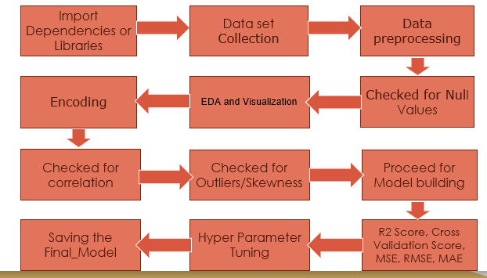
DATA ANALYSIS - MODEL BUILDING FLOWCHART

Slide 11
DATA PRE PROCESSING
Importing the necessary dependencies and libraries.
Reading the CSV file and converted into data frame.
Checking the data dimensions for the original dataset.
Looking for null values and accordingly fill the missing data.
Checking the summary of the dataset.
Checking unique values.
Checking all the categorical columns in the dataset.
Visualizing each features using matplotlib and seaborn.

Slide 12
EXPLORATORY DATA ANALYSIS (EDA) AND VISUALIZATION
01. Univariate Analysis -Univariate analysis is the simplest form of analyzing data. “Uni” means “one”, so in other words your data has only one variable.
02. Multivariate Analysis - Multivariate analysis is a set of statistical techniques used for analysis of data that contain more than one variable.
03. Correlation of Dataset - Correlation is used to test relationships between quantitative variables or categorical variables.
04. Correlation with Target variable - Correlation with the target variable to know how the data is related.
05. Skewness – We removed all skewness using Power Tranformer
06. Selecting Best Feature – We are Using PCA Technique to remove unwanted Columns .
05. Conclusion - Summary with the conclusion of all the analysis
-

Slide 13
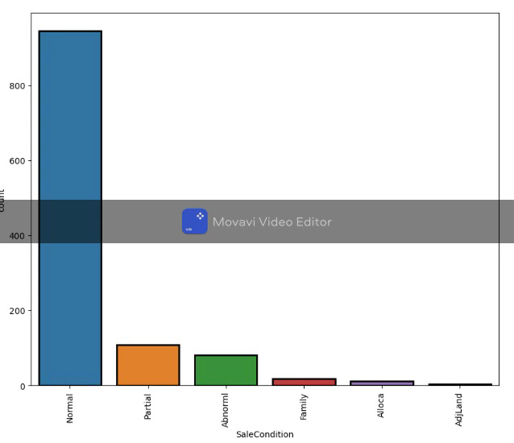
Lets see univariate analysis In video
Count plot method is used to show the counts of observations in each categorical bin using bars.
Parameters : This method is accepting the following parameters that are described below: x, y
This parameter take names of variables in data or vector data, optional inputs for plotting long-form data

Slide 14
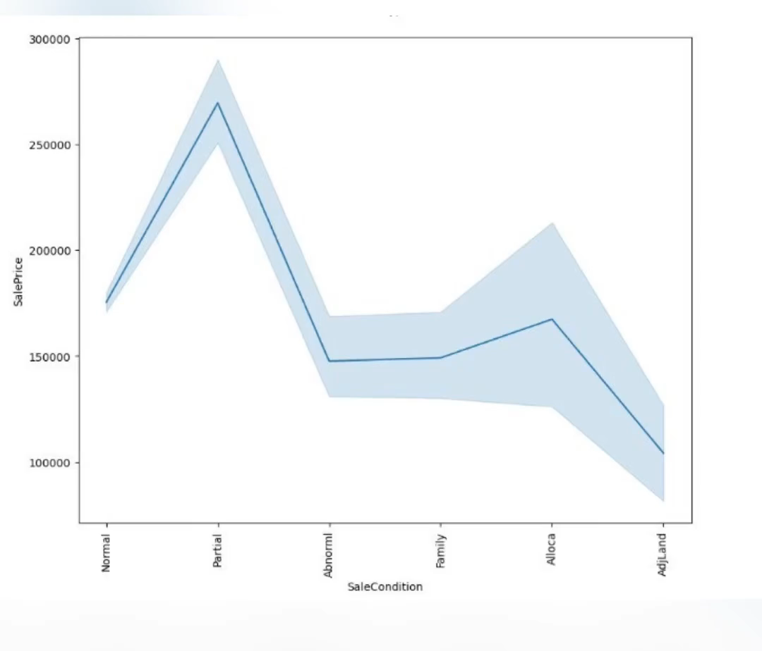
Categorical variable with sale price
Here , I am using Line plot for checkinh relationship between all categorical variable with our target variable Sale price.
Here I am making video of all the Line plot with all columns.

Slide 15
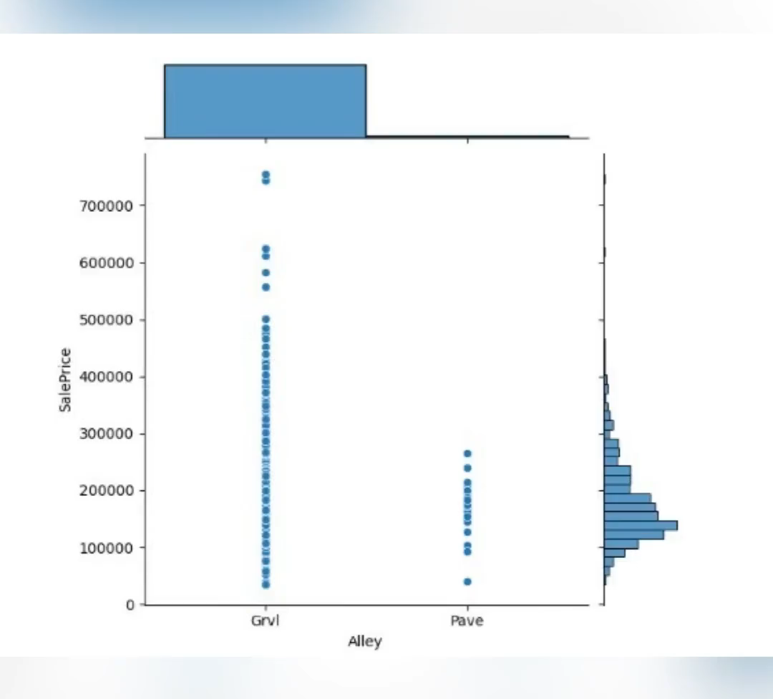
Joint plot for categorical variables with sales price
Here , I am using Joint plot for checkinh relationship between all categorical variable with our target variable Sale price.
Here I am making video of all the Line plot with all columns.

Slide 16
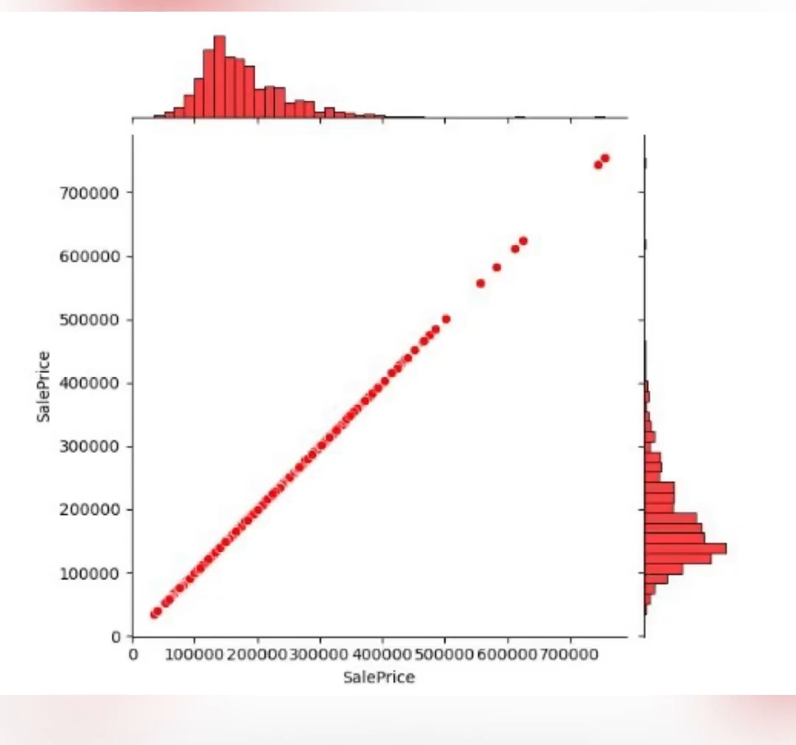
Jointplot for numerical variables with sales price
Here , I am using Joint plot for checkinh relationship between all categorical variable with our target variable Sale price.
Here I am making video of all the Line plot with all columns.
Here I am make videos for all columns.

Slide 17
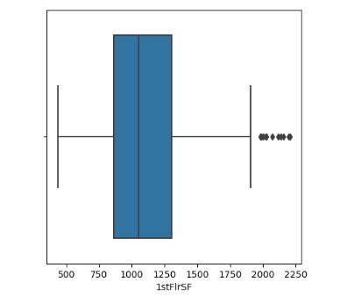
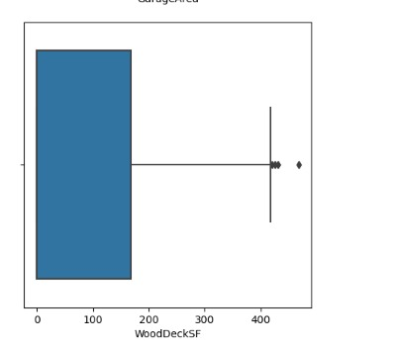
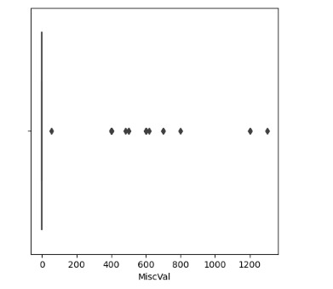
Column with outliers

Slide 18
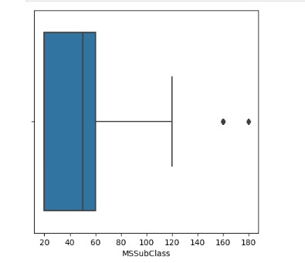
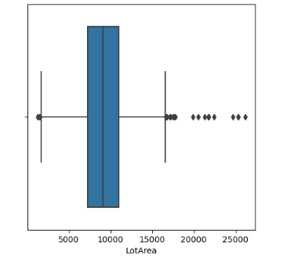
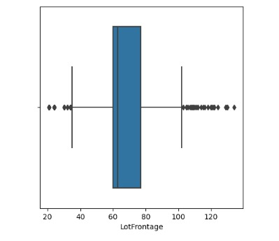

Slide 19
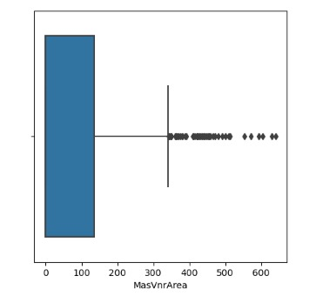
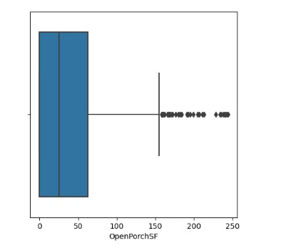
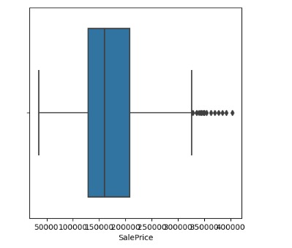

Slide 20
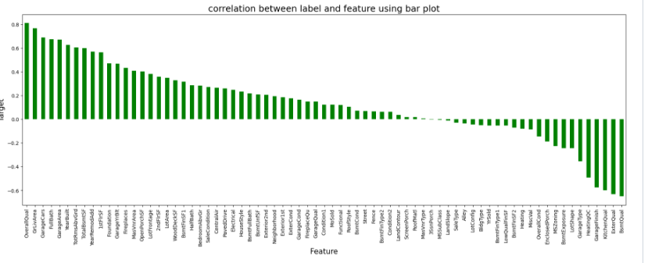
Checking correlation with target

Slide 21
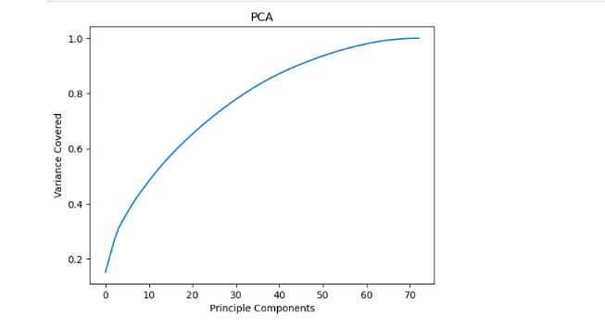
Feature selection pca technique
Around 60 principle components are able to to explain >95% Variance . its save to consider starting 60 PC.

Slide 22
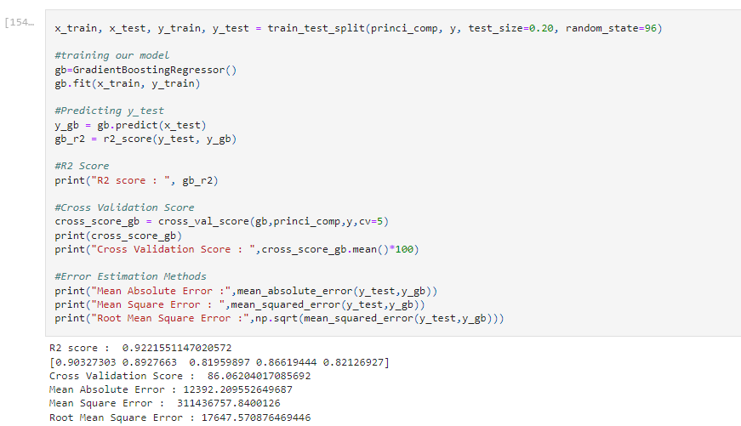
Selecting model
Here we select
Gradient Boost Regessor
For model building because
We get 92% R2 Score and
CV Score -> 86,
We select Gradient Boost and Move foreword to hyperparameter tuning.

Slide 23
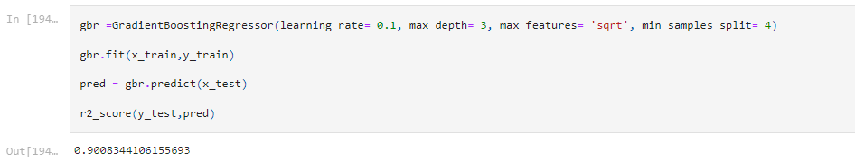
Hyperparameter Tuning
Here we tune the parameter and get the best accuracy 90% .

Slide 24
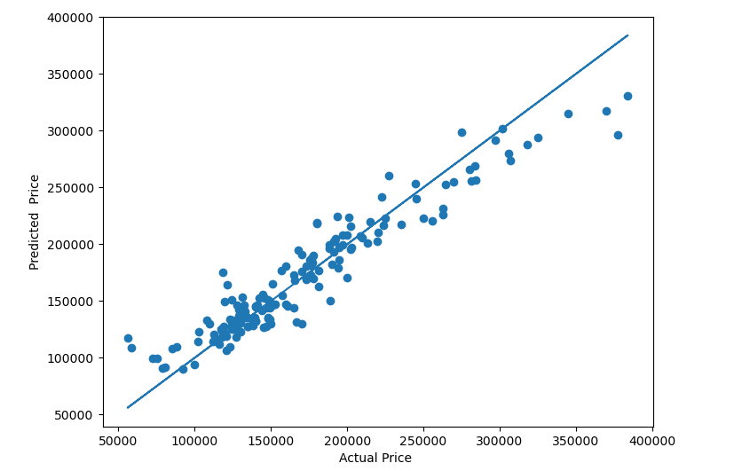
Best Fit line

Slide 25
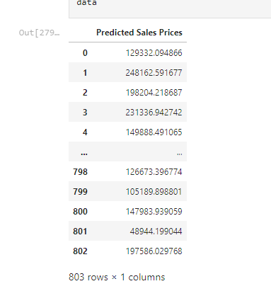
Prediction with test data

Slide 26
CONCLUSION AND SCOPE FOR FUTURE WORK
During this project I have faced a problem of low amount of data for training the machine learning models upon.
Many columns are with same entries in more than 80% of rows which lead to reduction in our model performance.
One more issue present is there are large number of missing values in this data set, so we have to fill those missing values in correct manner manually.
We can still improve our model accuracy with some feature engineering and by doing some extensive hyperparameter tuning on it.

Slide 27
Thankyou

